Slide 1
WAP in C++ to determine force using:
Force = mass * acceleration
WAP in C++ to pressure using:
Pressure = Force/Area

Slide 2
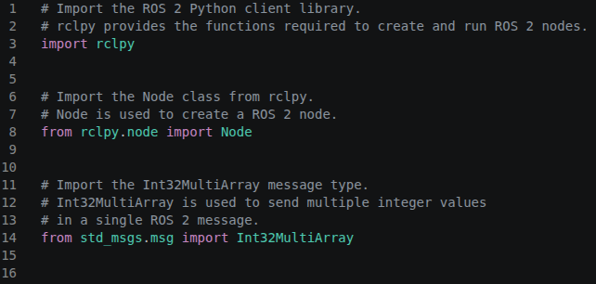

Slide 3
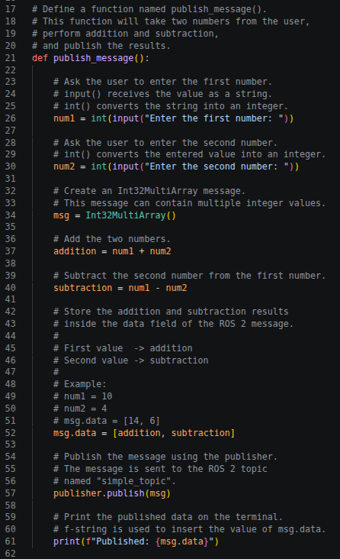
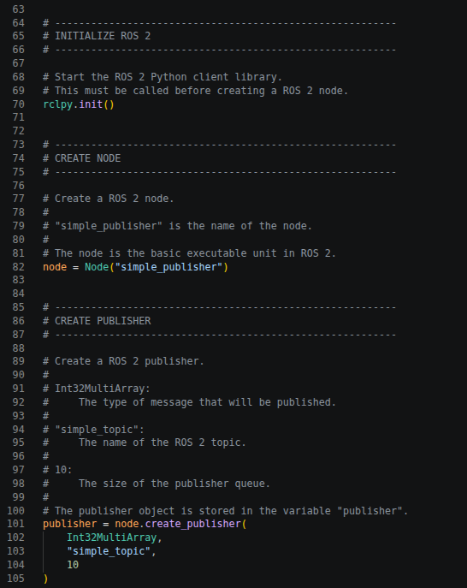

Slide 4
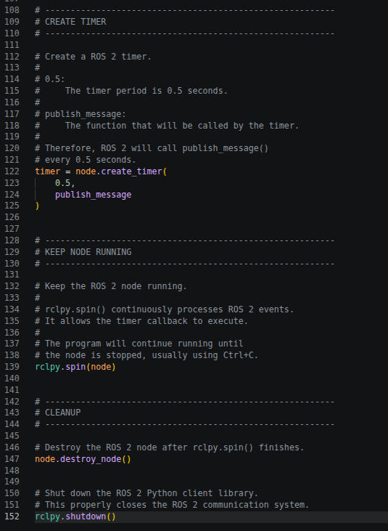

Slide 5
For example:
Enter the first number: 20
Enter the second number: 5
Addition = 25
Subtraction = 15
Published: [25, 15]
Then another ROS 2 node can subscribe to /simple_topic and receive [25, 15].

